Slide 1


MIS 587 – Group 5
Analyzing Loan Repayment Behavior

Slide 2






OUR TEAM
Apurva Atalkar
Rashmi Rao
Megan McKenna
Priyal Dani
Ahhaan Badhwar
Megan | 1

Slide 3

AGENDA
01
Overview - Background
02
Dimensional Modeling
03
Datawarehouse Design/ETL
04
Data Preparation
05
Data Exploration
06
Data Analysis
07
Business Implications & Recommendations
Megan | 2
Notes:
Animation issue

Slide 4
BACKGROUND
In emerging markets, having access to credit is crucial for both individuals and businesses to seize economic opportunities
A major issue is the lack of detailed credit histories for most people
Therefore, financial institutions face the challenge of evaluating the creditworthiness of individuals
This leads to two main problems:
People are unable to get credit at all
They receive loans with unsustainable terms
This situation highlights the urgent need for new methods of assessing credit
Megan | 3

Slide 5




PROBLEM STATEMENT
Predicting Credit Worthiness in the Absence of Credit History
Challenge: Developing a method to predict loan
repayment ability without credit history
Limitation of Current Systems: Traditional credit
scoring mechanism miss
potential borrowers in
emerging markets
Impact: Enhancing financial inclusion by enabling access to credit for
under-served populations
Approach: Utilize the Home Credit Default Risk dataset to build a warehouse and analyze the data
Megan | 5

Slide 6
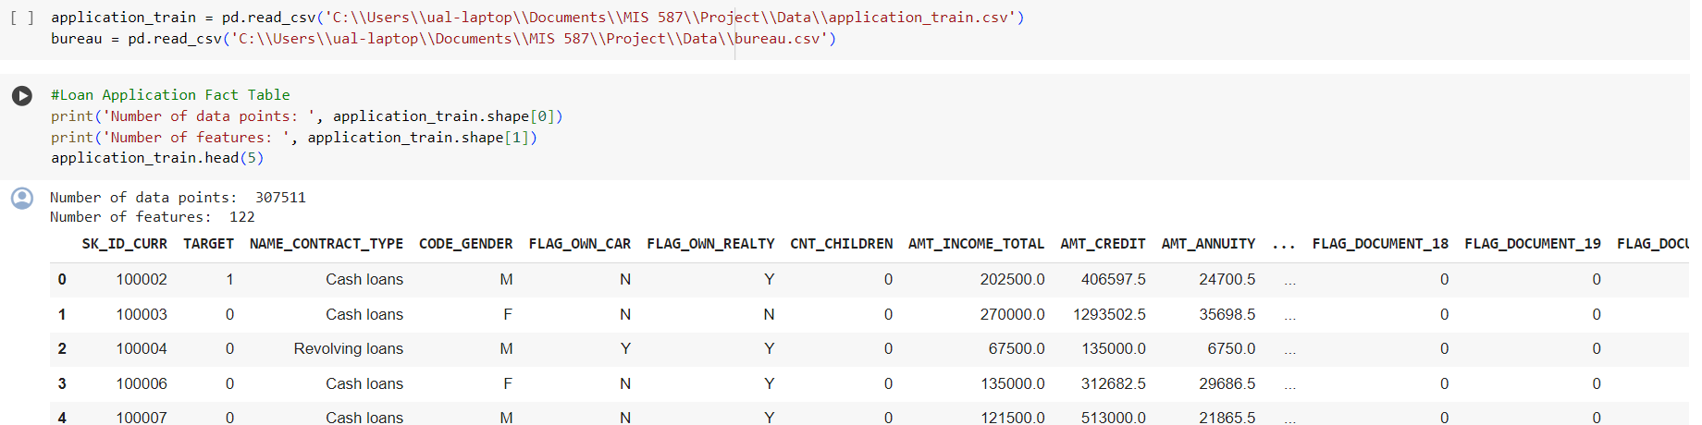
DATASET OVERVIEW
FACT TABLE – LOAN APPLICATION TABLE
Number of Records – 307K Number of Features – 122
Megan | 6
Notes:
Brought it down to 28 features.

Slide 7



DIMENSIONAL MODELING
Data Grain
Dimensions
Each row represents a single loan application
Gender
Education Type
Contract Type
Organization Type
Business Process
Facts
Determining Credit Worthiness of Applicants
Amount Credit
Amount Income
Amount Debt
Amount Annuity
Megan | 7

Slide 8
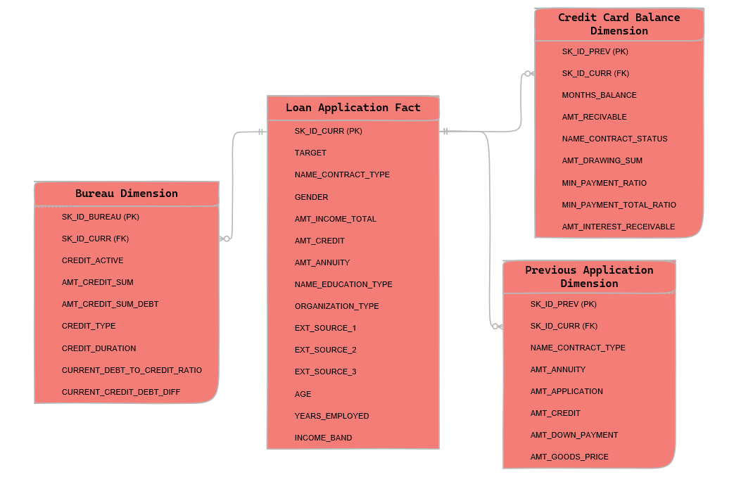
STAR SCHEMA
Megan | 8

Slide 9
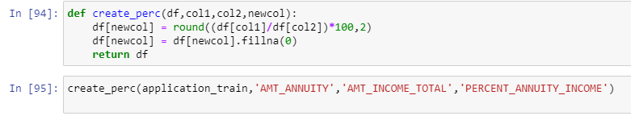
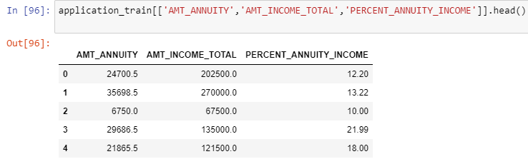
WAREHOUSE DESIGN IMPLEMENTATION
Apurva | 9
Notes:
PERCENT_ANNUITY_INCOME to indicate the loan annuity amount relative to the person's total income

Slide 10
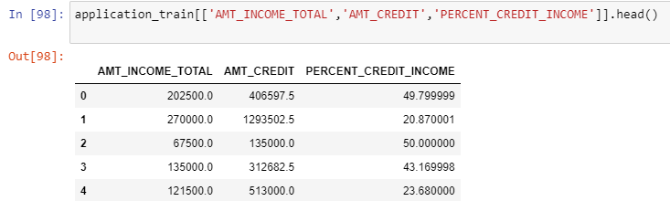
WAREHOUSE DESIGN IMPLEMENTATION
Apurva | 10
Notes:
CREDIT_TERM: Indicates the length of the payment period in months, considering that the annuity is the monthly payment.
DAYS_EMPLOYED_PERCENT: Reflects the percentage of days employed relative to the client's age.

Slide 11
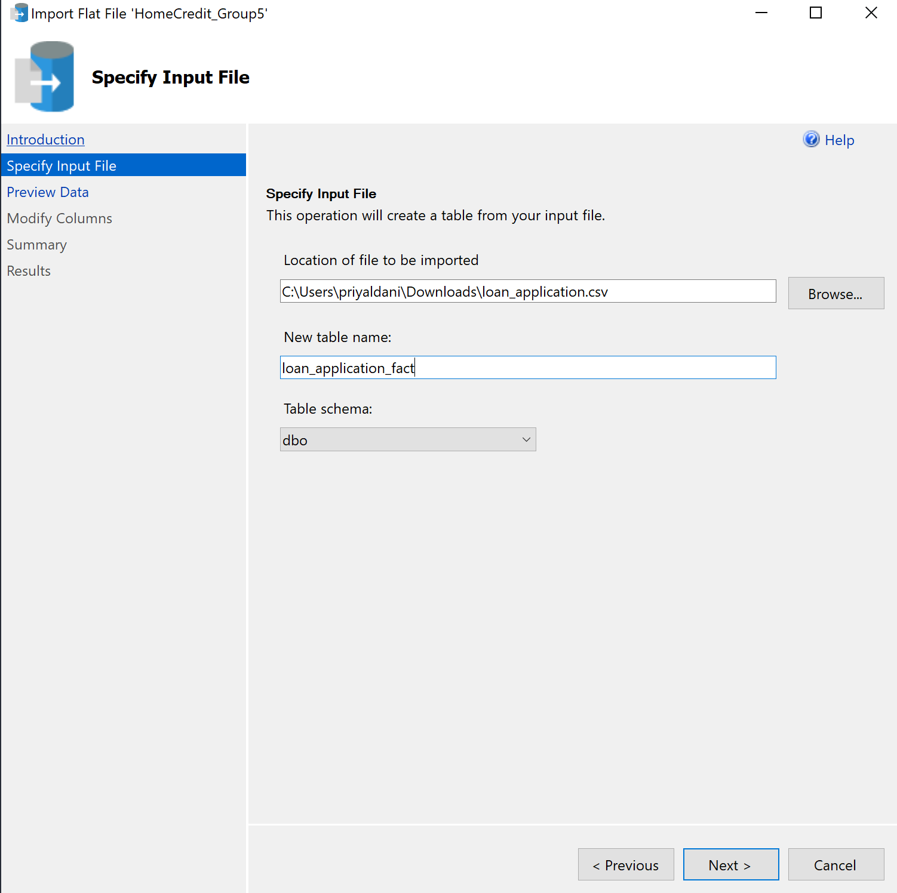
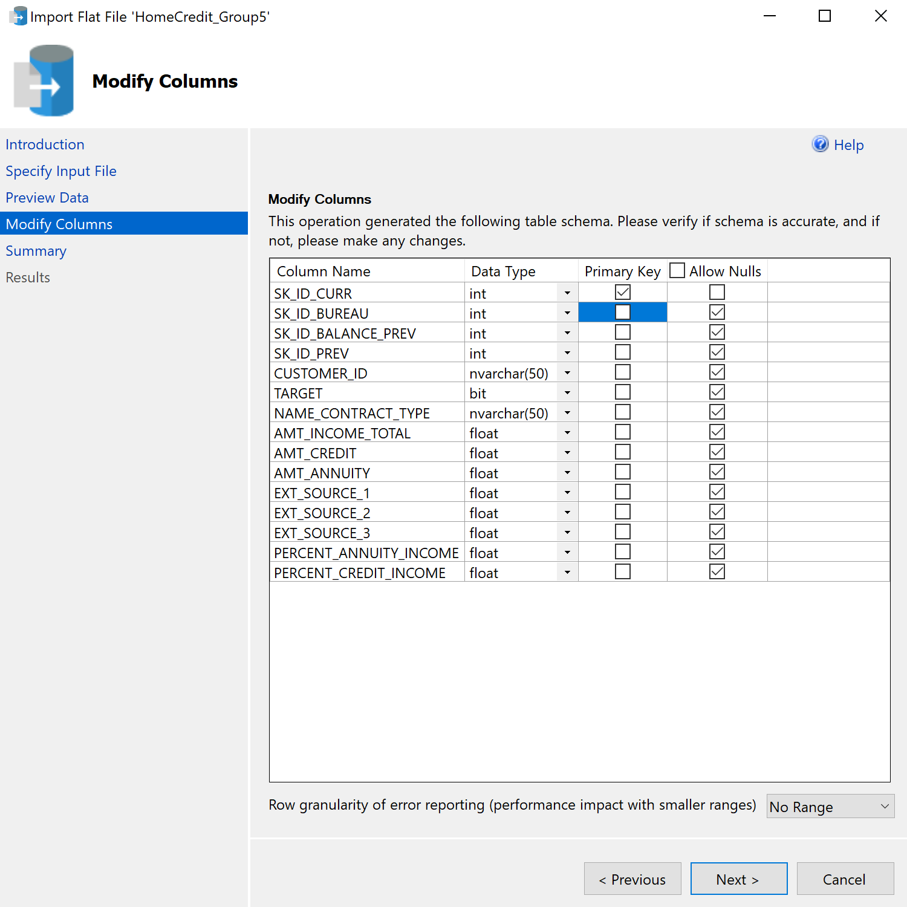
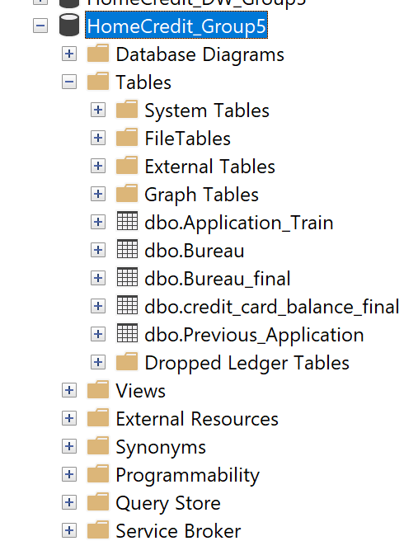
WAREHOUSE DESIGN IMPLEMENTATION
Apurva | 11

Slide 12
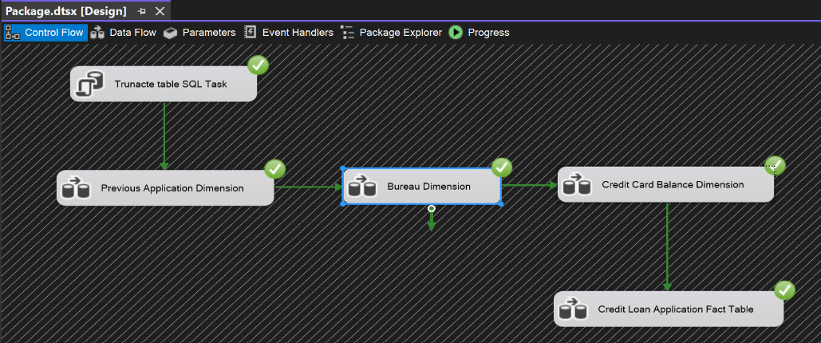
WAREHOUSE DESIGN IMPLEMENTATION
Apurva | 12

Slide 13
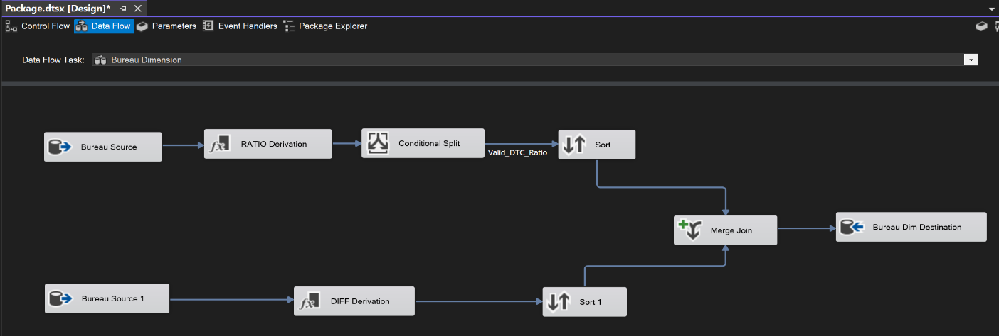
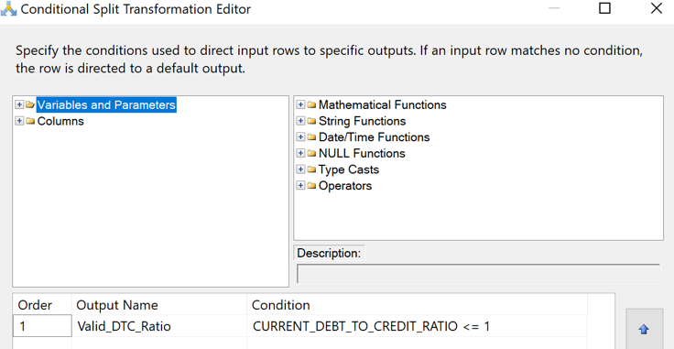
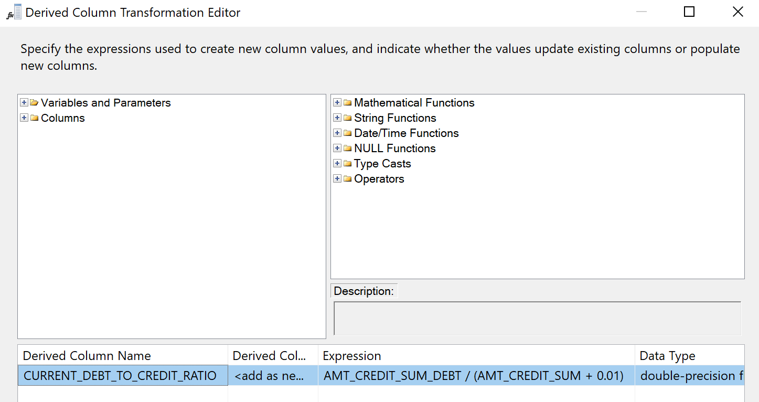
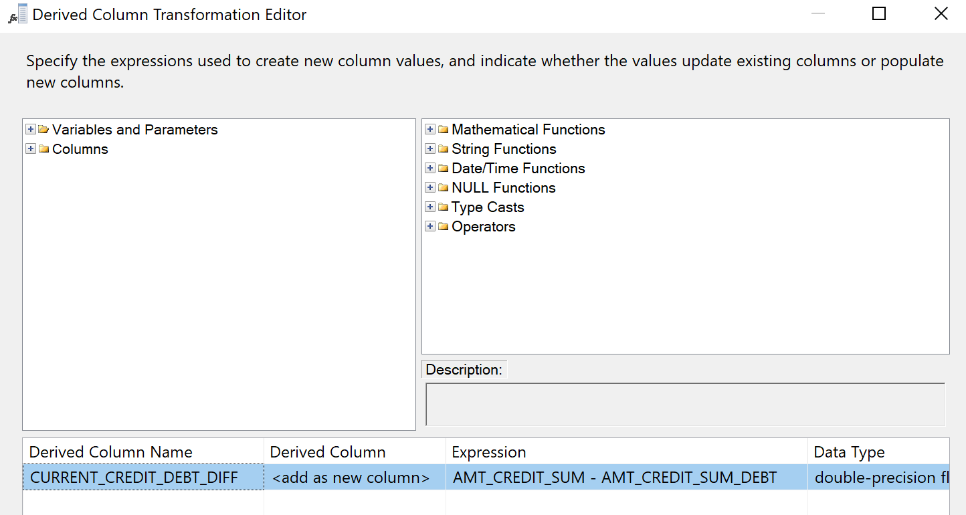
WAREHOUSE DESIGN IMPLEMENTATION
Apurva | 13

Slide 14
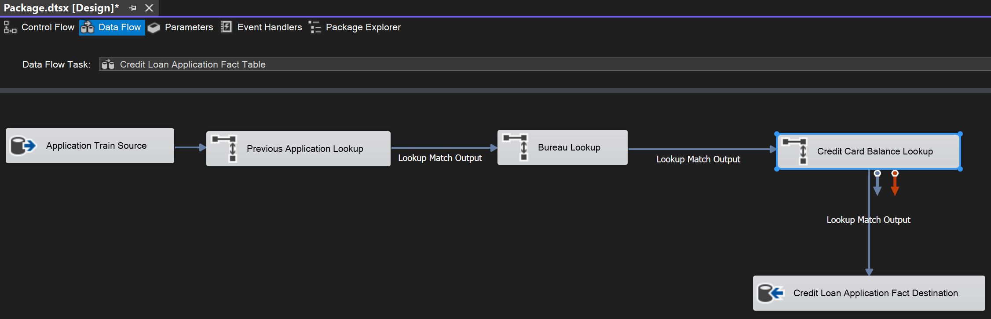
WAREHOUSE DESIGN IMPLEMENTATION
Apurva | 14

Slide 15
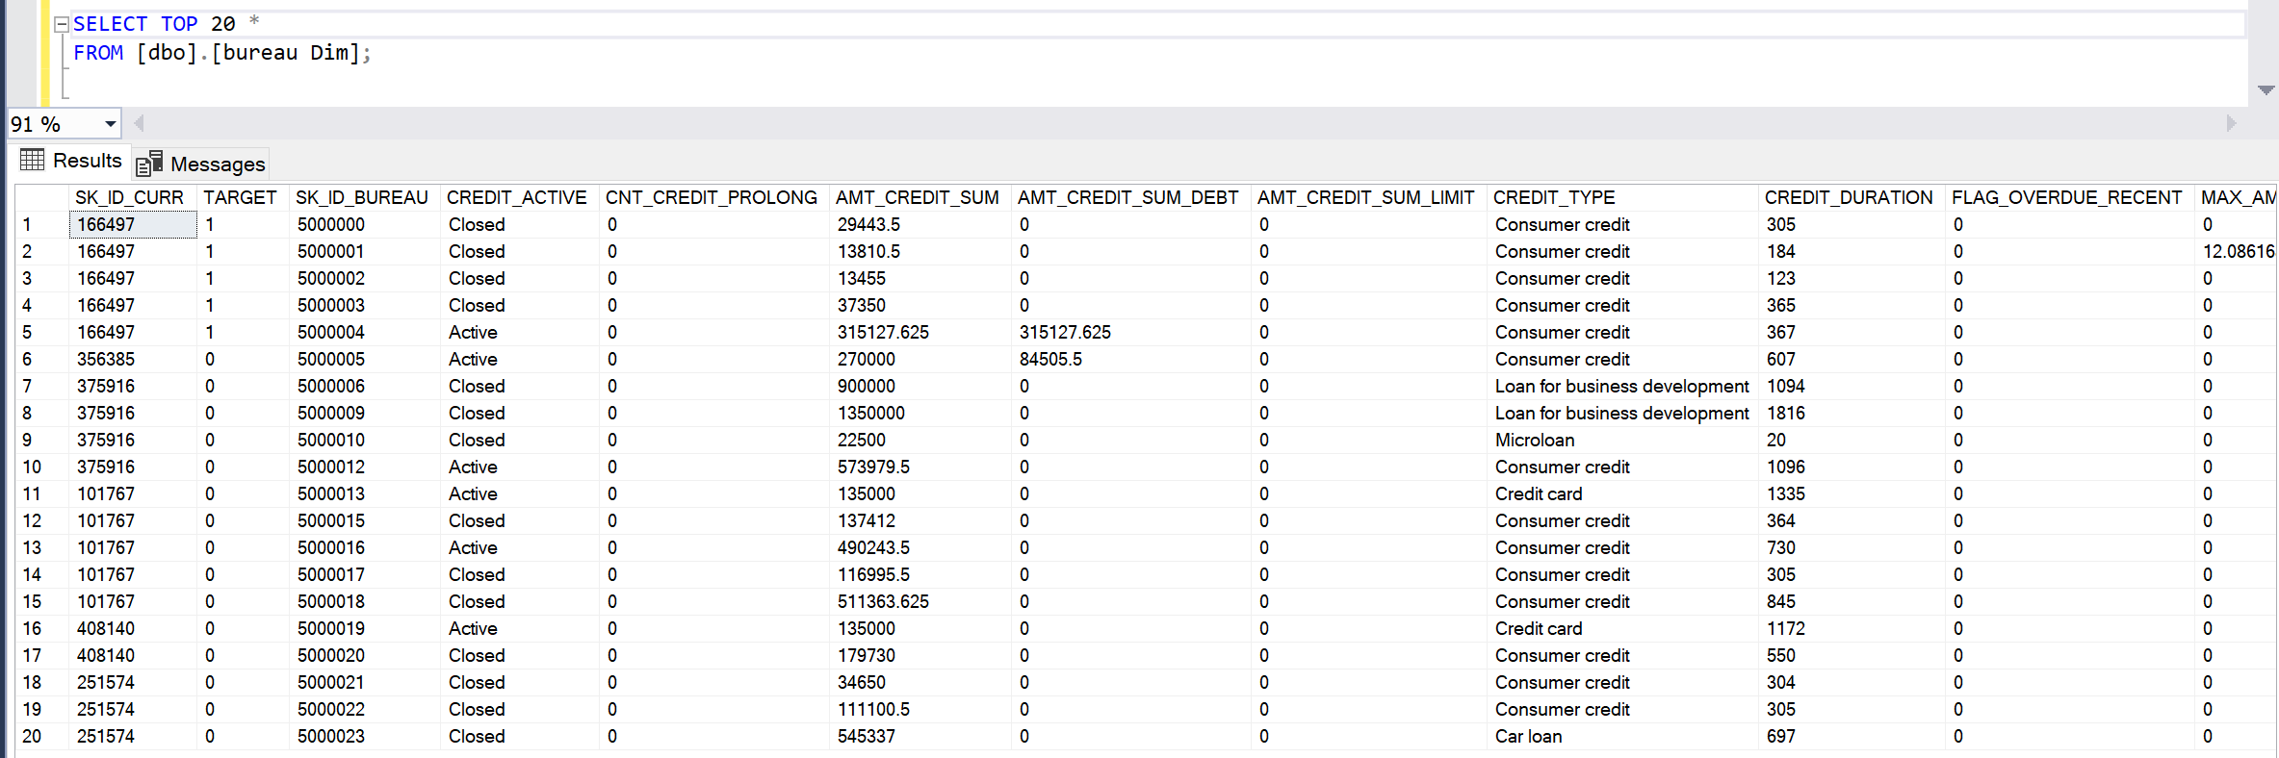
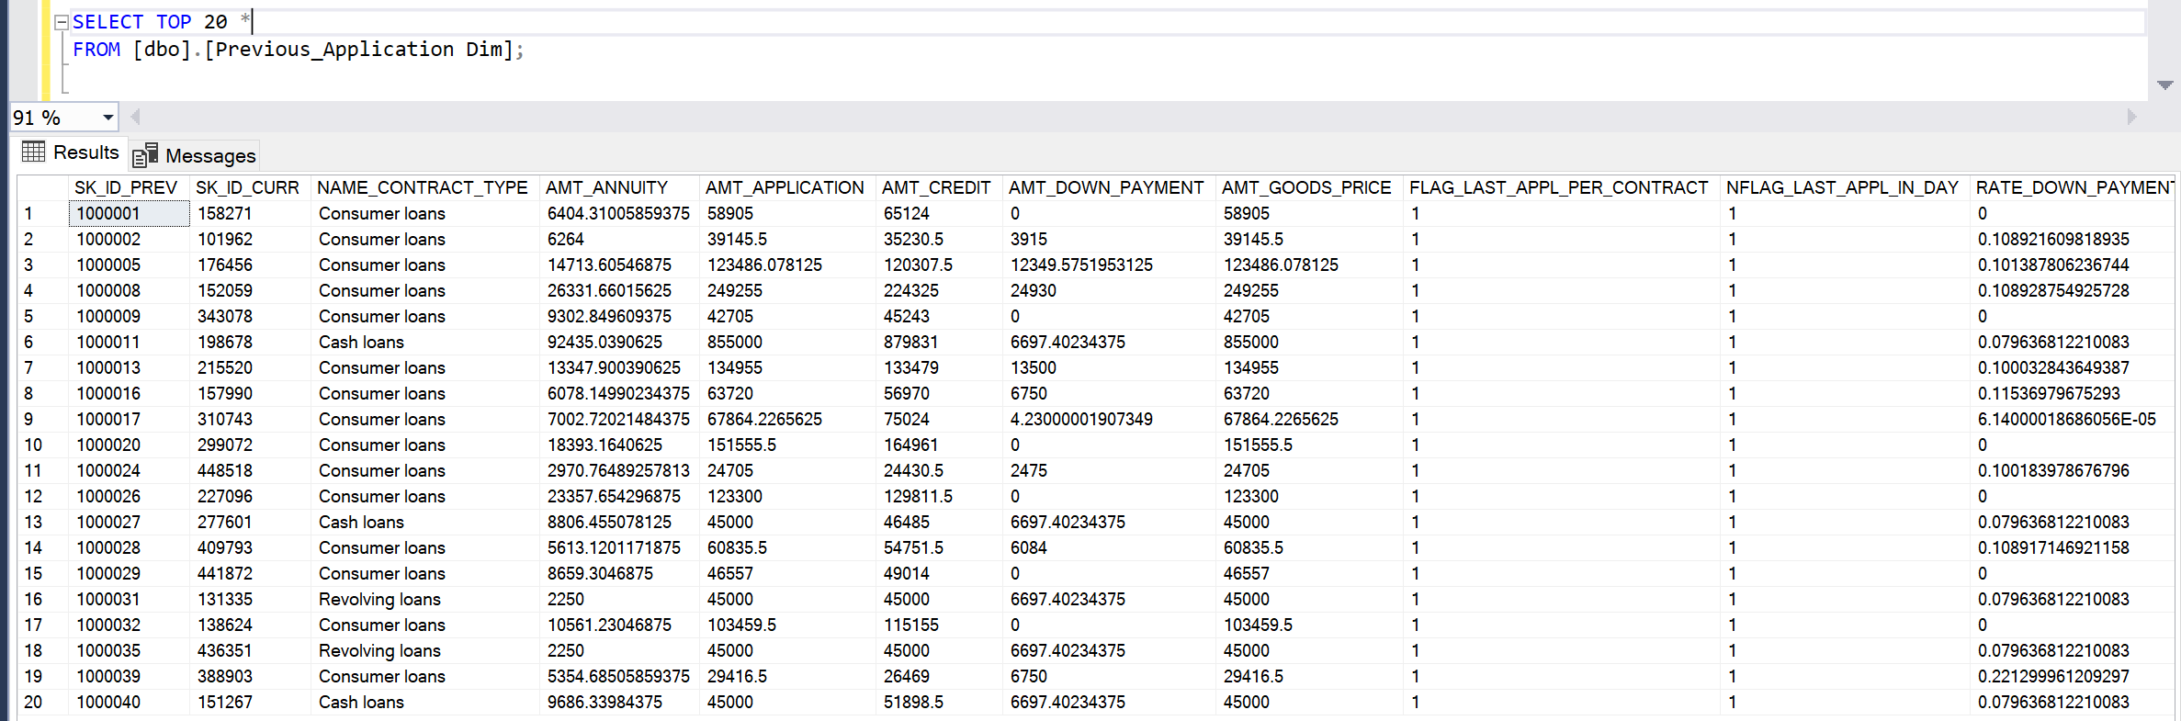
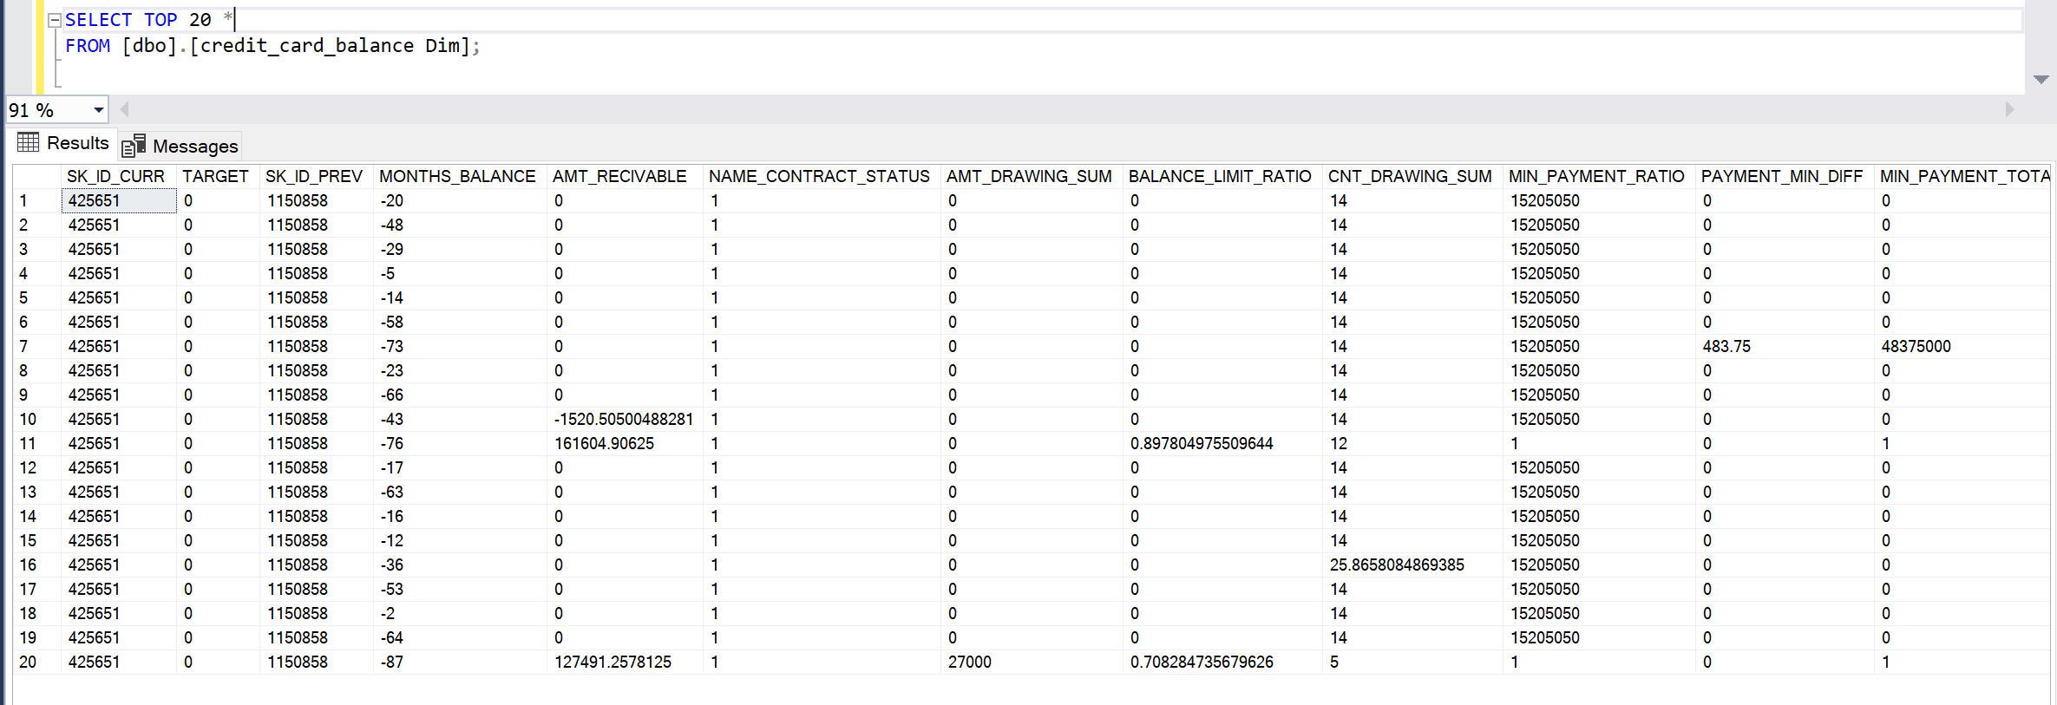
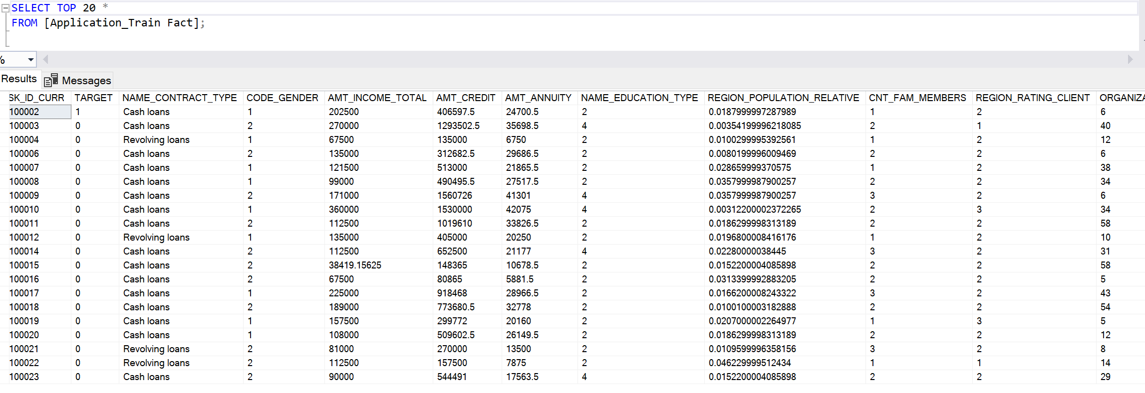
WAREHOUSE DESIGN IMPLEMENTATION
Apurva | 15

Slide 16


DATA PREPARATION
OUTLIER DETECTION & REMOVAL
The attributes – DAYS_EMPLOYED & AMT_INCOME_TOTAL
Both the features are from the main Fact Table – Loan Application
The column DAYS_EMPLOYED contains negative values and one notably large positive value of 365,243 days, equivalent to about 1000 years, appearing frequently
The data shows a wide range in AMT_INCOME_TOTAL, from a minimum of 25,650 to a maximum of 117,000,000. The 75th percentile is at 202,500, indicating that 75% of customers earn this amount or less
Rashmi | 16
Notes:
days_employed - How many days before the application the person started current employment
AMT_INCOME_TOTAL - Income of the client
DAYS_EMPLOYED is having inconsistent data. It contains negative values (since it is in the form of 'days' relative to the application), then suddenly there is one very big positive number (365243 days - which equates to 1000 years!) with a significant number of individuals having it.
AMT_INCOME_TOTAL has an outlier. As per the data: the 75th percentile is equal to 202,500, while the maximum value is equal to a one hundred seventeen million; It is quite a big difference as it means that 75% of our customers are already making a total income of 202,500 or below - the remaining 25% has a total income higher than 202,500. AMT_INCOME_TOTAL has a wide range of values, from min val 25,650 to max val 117,000,000.

Slide 17
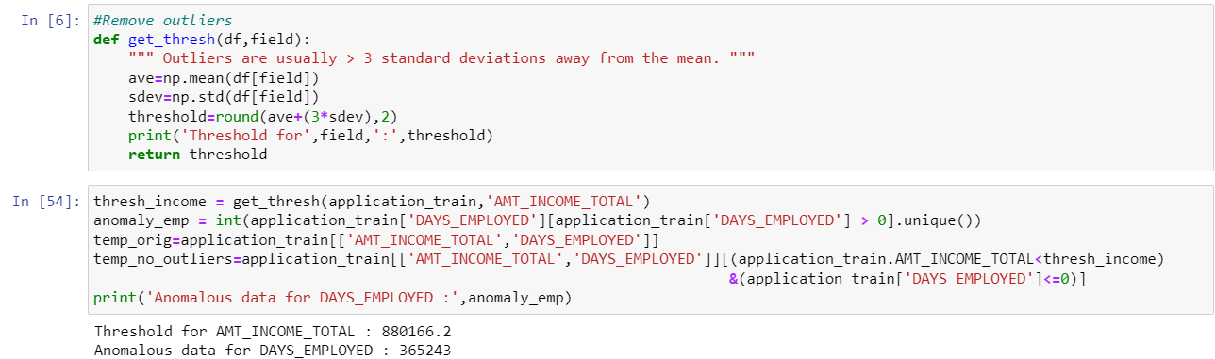
DATA PREPARATION
OUTLIER DETECTION & REMOVAL
Rashmi | 17
Notes:
Both the tables are from the main Fact Table – Application

Slide 18

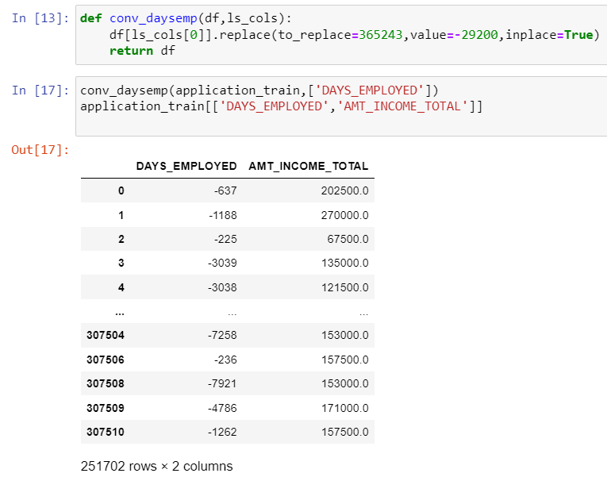
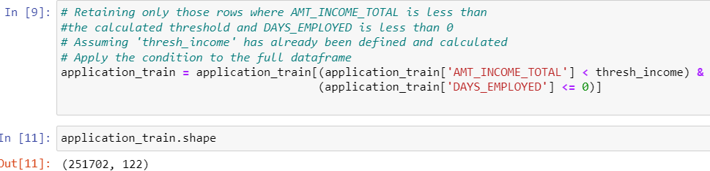
DATA PREPARATION
OUTLIER DETECTION & REMOVAL
Convert anomalous data in DAYS_EMPLOYED which is 365243 days (1000 years) to -29200 days (equal to 80 years)
To address outliers in AMT_INCOME_TOTAL, retain only those rows which are less than the calculated threshold
Rashmi | 18
Notes:
Both the tables are from the main Fact Table – Application
About 20% data removed

Slide 19
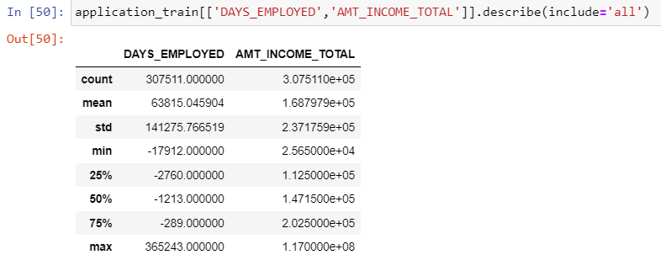
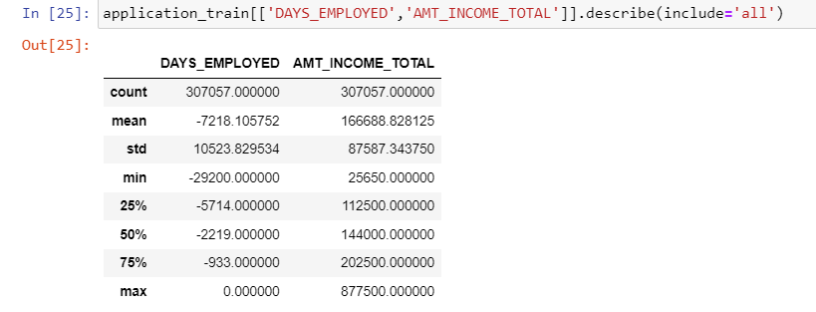
DATA PREPARATION
OUTLIER DETECTION & REMOVAL
BEFORE OUTLIER REMOVAL
AFTER OUTLIER REMOVAL
Rashmi | 19
Notes:
Both the tables are from the main Fact Table – Application

Slide 20

DATA PREPARATION
MISSING VALUES
The attributes – EXT_SOURCE1, EXT_SOURCE2, EXT_SOURCE3 & OCCUPATION_TYPE
Both the features are from the main Fact Table – Loan Application
For the continuous variables, we used the mean to fill in missing values, as mean imputation is well-suited for numerical data
Created a new category ‘Data Not available’ to fill in the missing values
Rashmi | 20
Notes:
Both the tables are from the main Fact Table – Application
Explain what external sources are and occupation type – examples
Say that its related to target
OCCUPATION_TYPE has 31% of its values missing. Majority of the null OCCUPATION_TYPE are from pensioners

Slide 21
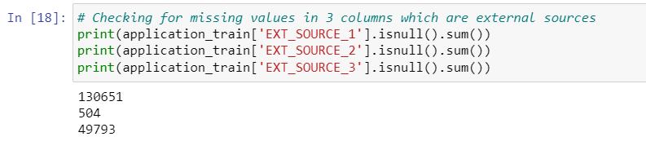
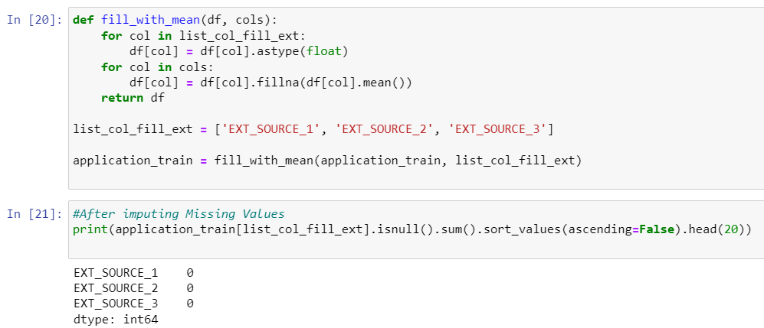
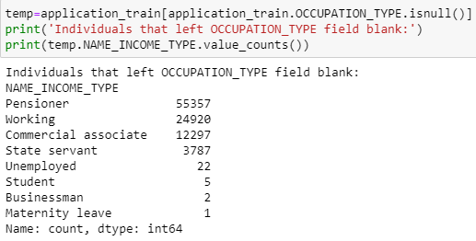
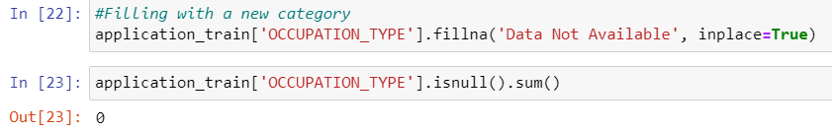
DATA PREPARATION
MISSING VALUES
BEFORE MISSING VALUES REMOVAL
AFTER MISSING VALUES REMOVAL
Rashmi | 21
Notes:
Both the tables are from the main Fact Table – Application
OCCUPATION_TYPE has 31% of its values missing. Majority of the null OCCUPATION_TYPE are from pensioners

Slide 22

DATA TRANSFORMATION
LABEL ENCODING
The attributes– CODE_GENDER, NAME_EDUCATION_TYPE, ORGANIZATION_TYPE
All are categorical variables
Transformed the categorical columns using Label Encoding. Considering the space, our dataset is large enough which is why we decided to not do One-hot
Rashmi | 22
Notes:
Both the tables are from the main Fact Table – Application
These attributes will help Home credit understand if an individual will repay the loan.

Slide 23
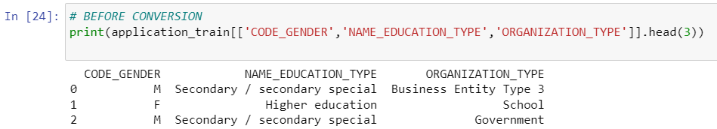
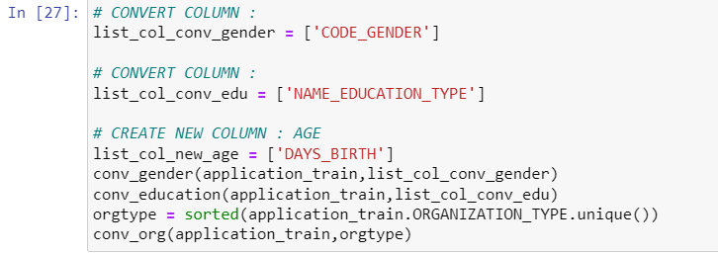
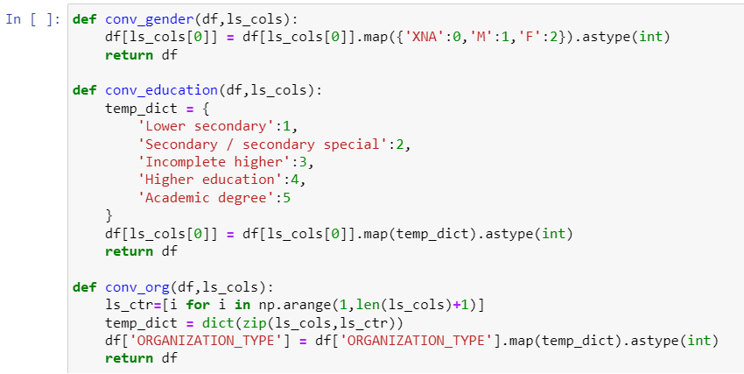
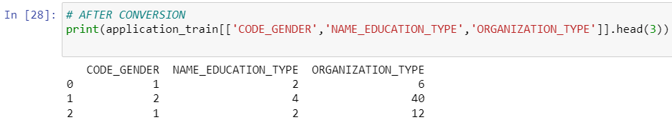
DATA TRANSFORMATION
LABEL ENCODING
BEFORE ENCODING
AFTER ENCODING
Rashmi | 23
Notes:
Both the tables are from the main Fact Table – Application

Slide 24
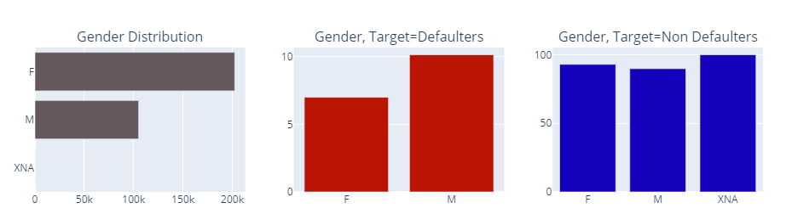
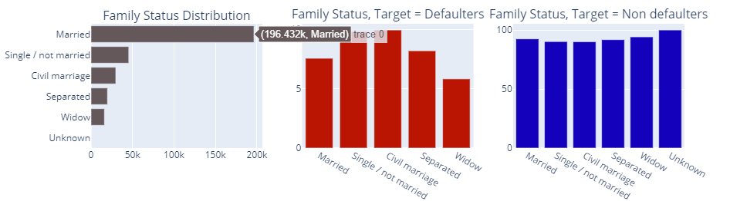
DATA EXPLORATION
More women have applied for loans
But men default more than women
Married people have applied for a large proportion of loans
But the single, civil married and separated applicants have higher chance of being defaulters
Rashmi | 24
Notes:
More women have applied for loans (about twice the number of men). But if you look at target variables, men default more than women. Around 10% of the total men re defaulters here compared to 7% for women applicants
Married people have applied for a large proportion of loans. But the single, civil married and separated applicants have higher chance of being defaulters

Slide 25
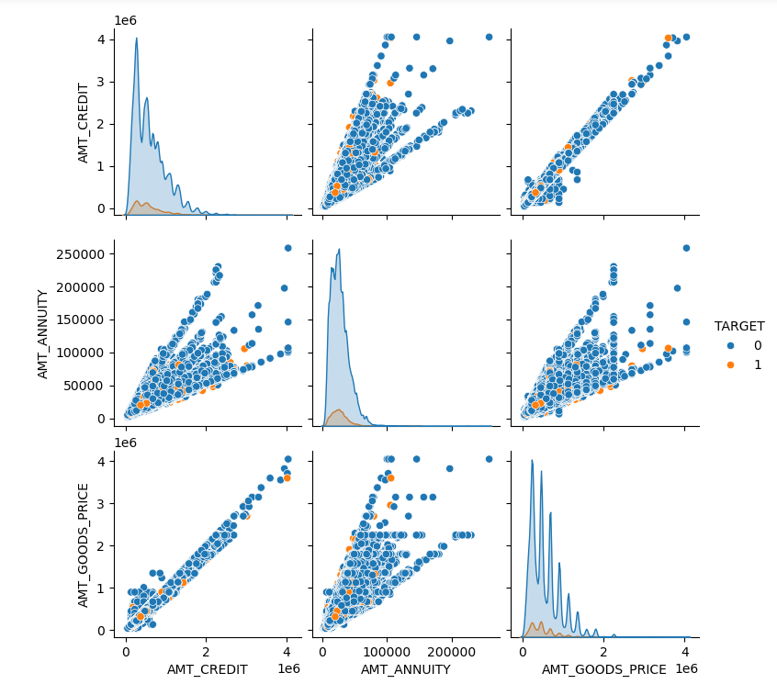
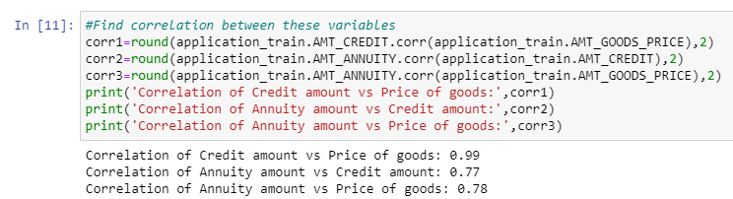
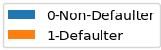
DATA EXPLORATION
AMT_CREDIT and AMT_GOODS_PRICE are highly correlated, higher the loan of goods, higher the credit amount of the loan
AMT_CREDIT and TARGET are correlated; it is a good indicator to predict loan
Rashmi | 25
Notes:
Pairplot
AMT_CREDIT - Credit amount of the loan
AMT_GOODS_PRICE - For consumer loans it is the price of the goods for which the loan is given
AMT_ANNUITY - annuity is the monthly due amount.
* AMT_CREDIT and AMT_GOODS_PRICE are highly correlated (scoring 0.99!), and has a positive linear slope - which makes sense because as the price of goods for which the loan is given gets higher, the credit amount of the loan (ofcourse) gets higher too.
* AMT_ANNUITY is also highly correlated to AMT_CREDIT and AMT_GOODS_PRICE with a positive linearity. It's because the annuity is the monthly due amount.
* Decisions:
* AMT_GOODS_PRICE - to drop as it is quite redundant. We already have the AMT_CREDIT field to account for the loan amount.
* AMT_ANNUITY - create new feature PERCENT_ANNUITY_INCOME to indicate the loan annuity amount relative to the person's total income.
* AMT_CREDIT - create new feature PERCENT_CREDIT_INCOME to indicate the loan credit amount relative to the person's total income.

Slide 26
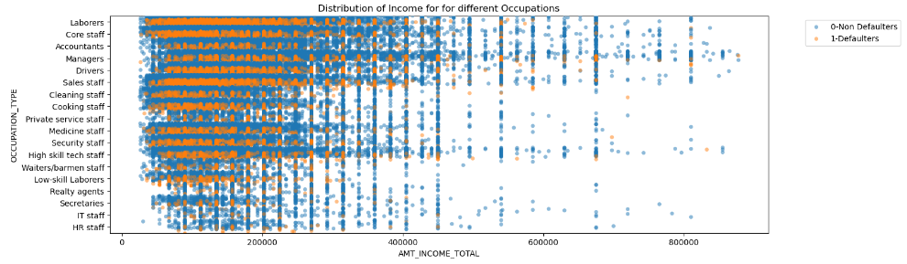
DATA EXPLORATION
It seems as if the laborers have the highest difficulty in repaying. Also, it seems lending to Realty agents, IT staff, HR staff is the safest.
Not a good way to conclude, biased number of applicants
Create a ratio of Repayors to Applicants
Rashmi | 26
Notes:
The plot shows a wide range of incomes across different occupations. Some occupations like Managers, IT staff, and High skill tech staff appear to have higher income ranges compared to occupations like Laborers, Cleaning staff, and Low-skill laborers.
Both defaulters (marked in orange) and non defaulters (marked in blue) are present across all occupations. It indicates that defaulting is not confined to specific income levels or occupations.
Defaulters are spread across all income brackets, there seems to be a noticeable presence of defaulters in the lower to middle income range across various occupations. This might suggest that individuals in these income brackets could be more vulnerable to defaulting, possibly due to less financial stability.
Right off the bat, it seems as if the labourers have the highest difficulty in repaying. Also it seems lending to Reality agents, IT staff, HR staff is the safest.
This is not a better way to conclude, because this contains baised number of applicants. A better way is to find a metric that incorporates relative relationship between applicants count and repayers count.

Slide 27
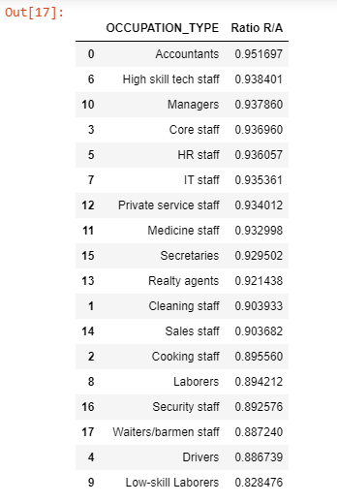
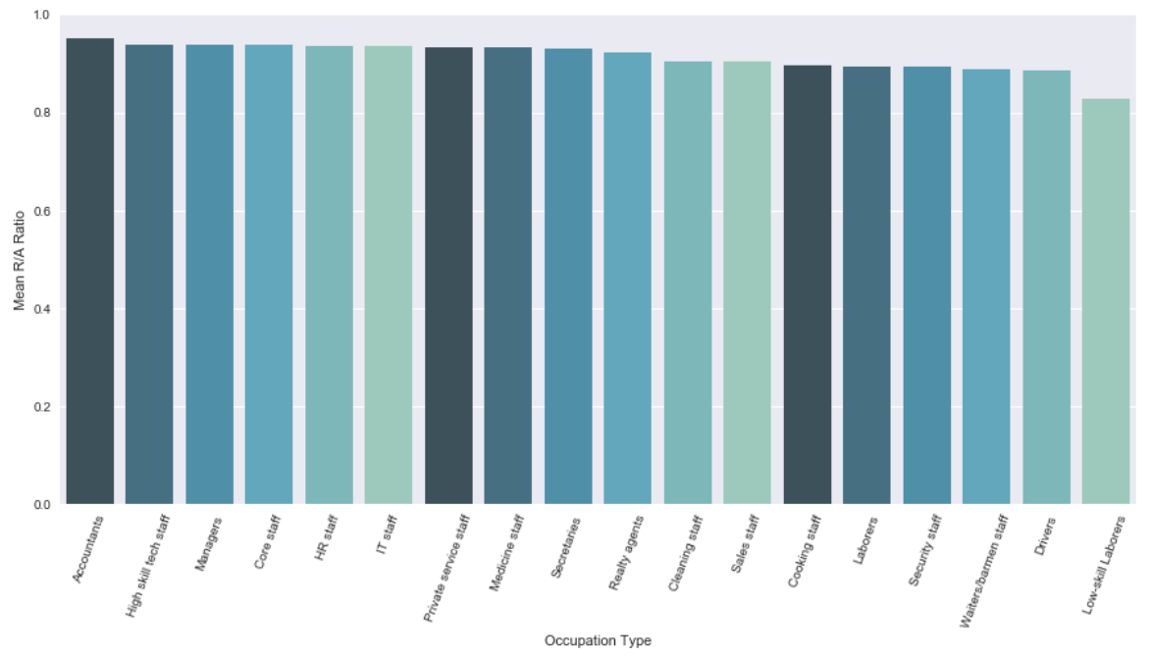
DATA EXPLORATION
Rashmi | 27
Notes:
Finds the ratio of Repayers to Applicants. This kind of is a measure for safety. Larger the value better the applicant - More safe for the company to lend loan to this category of workers.
According to the ratio of Number of repayers to Number of applicants in every occupation type, we see that it is most safe to lend money to Accountants with an R/A ratio of 0.9516 and it is least safe to lend money to low skilled labourers with an R/A ratio of 0.8284.

Slide 28
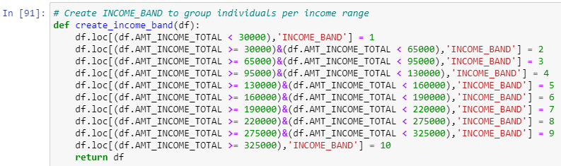
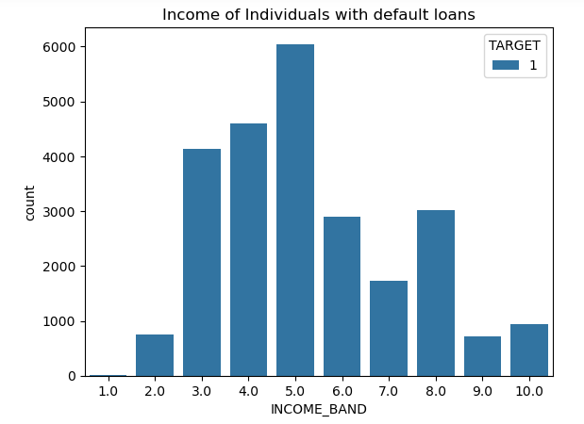
DATA EXPLORATION
The income band between 130k and 160k default the most
Rashmi | 28

Slide 29
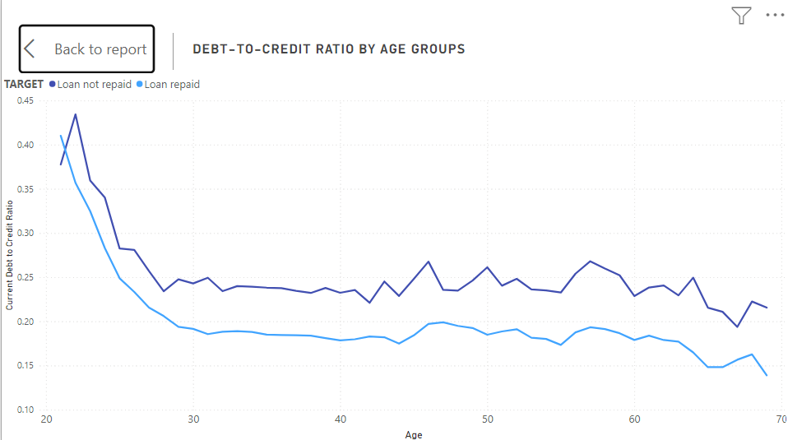
DATA ANALYSIS
Risk Assessment for the Lender
Higher ratio means higher risk for lender
High risk of default
Age group between 20-25 are at high risk of “Defaulting”
Priyal | 29
Notes:
A high debt-to-credit ratio, also known as credit utilization ratio, refers to the amount of debt you have compared to your available credit limit
A high debt-to-credit ratio indicates that you're using a large portion of your available credit, which can be seen as a higher risk by lenders.
For a home credit company, a high debt-to-credit ratio among applicants could signal potential financial instability or an increased likelihood of defaulting on mortgage payments.
By this we can understand the borrower's creditworthiness.

Slide 30
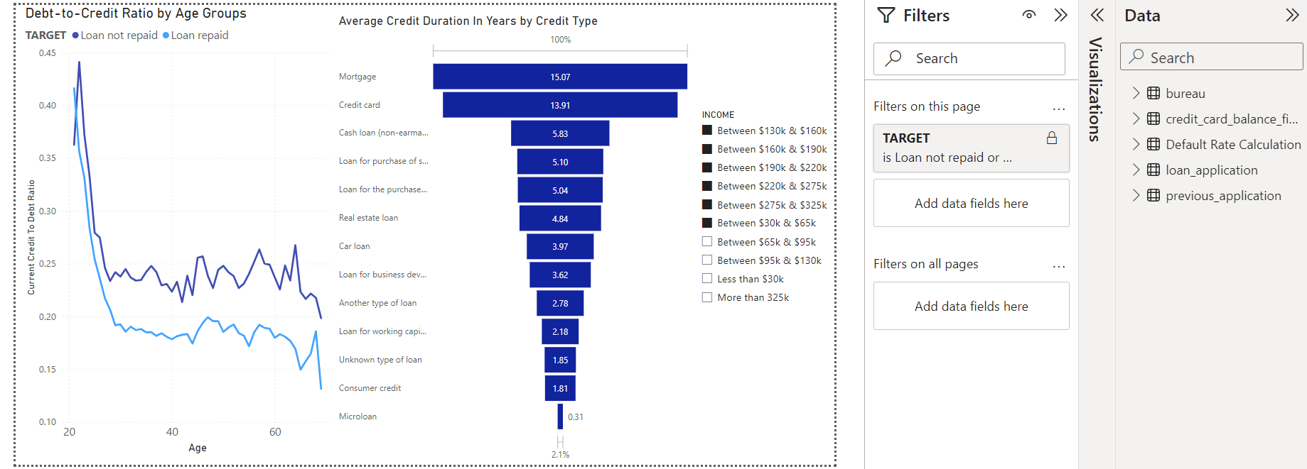
DATA ANALYSIS
Risk Assessment for the Lender
Highest percentage of Avg Credit Duration is for Mortgage and Credit Card
Diverse Credit Needs
Consumers are leveraging credit to support their spending habits & lifestyle choices
Priyal | 30
Notes:
A high average credit card duration suggests that borrowers are maintaining their credit card accounts for longer periods, indicating stability in their financial behavior. This stability may reflect responsible credit management and a lower likelihood of default.
High credit card duration may also indicate strong customer loyalty to the credit card issuer
a high percentage of mortgages and credit cards reflects the importance of these credit types in consumers' financial lives, highlighting diverse credit needs

Slide 31
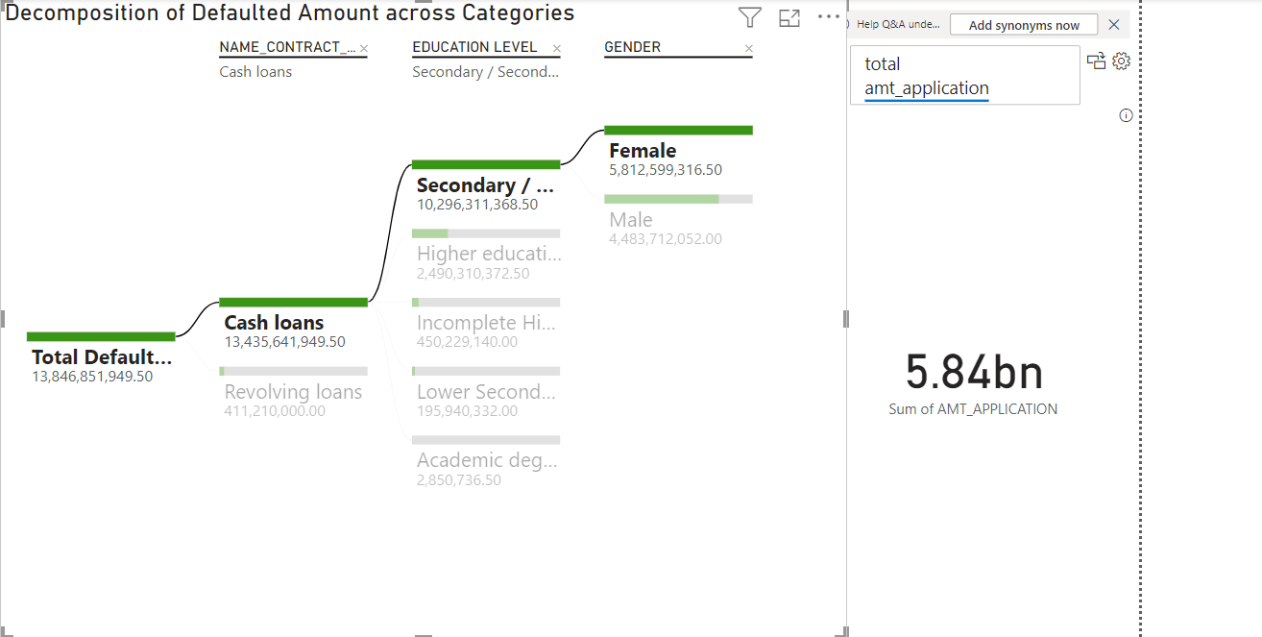
DATA ANALYSIS
Segmentation by Education Level & Gender
Defaulted loan amounts are higher for cash loans compared to revolving loans
Defaulted loan amounts are higher among Female borrowers compared to Male borrowers
Priyal | 31
Notes:
The analysis shows that defaulted loan amounts are higher for cash loans compared to revolving loans. This suggests that borrowers taking out cash loans may have a higher risk of defaulting on their loans, possibly due to the larger amounts involved or the longer repayment terms associated with cash loans.
Among customers, those with secondary education have a higher defaulted loan amount compared to other education levels. This could indicate that individuals with secondary education may face challenges in managing their finances or may have limited access to financial education resources, leading to a higher likelihood of default.

Slide 32
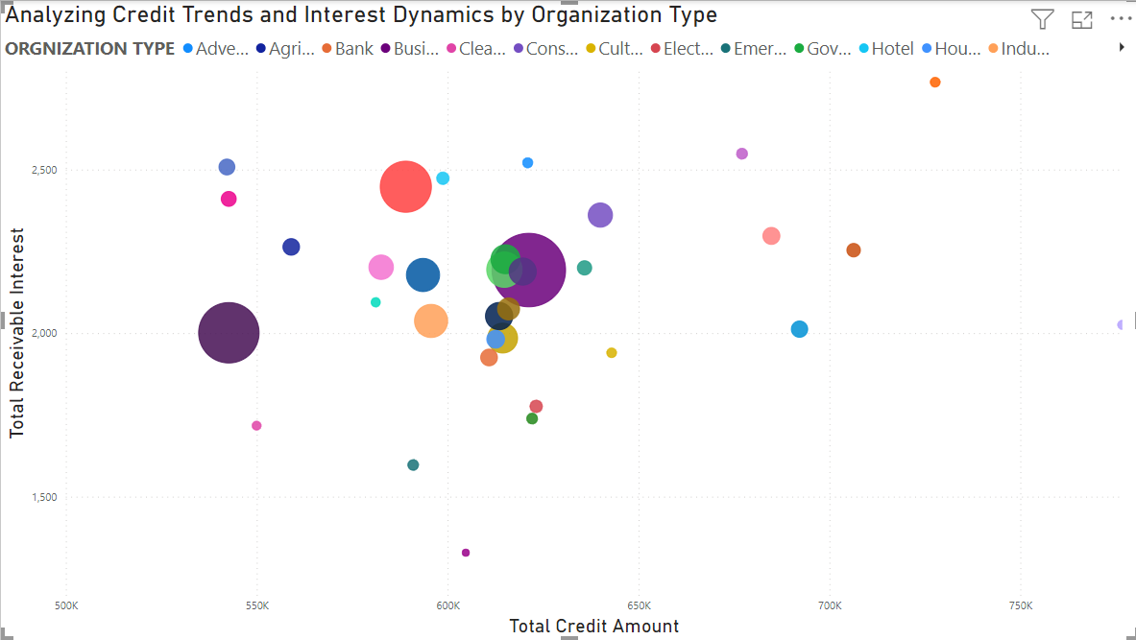
DATA ANALYSIS
Analyzing Credit Trends & Interest Dynamics by Org Type
Realtor, insurance companies and university have the highest total receivable interest and total amount representing high-interest borrowers
Represent a relatively small proportion of the borrower base
Expansion in lending relationships
Priyal | 32
Notes:
Concentration of High-Interest Borrowers: The presence of realtors, insurance companies, and universities with high total receivable interest suggests that these organizations may represent high-interest borrowers. They may be borrowing larger amounts of credit at comparatively higher interest rates, leading to higher receivable interest for the lender.
the small size of the blob suggests that they represent a relatively small proportion of the borrower base
Opportunities for Growth: While the size of the blob may be small for realtors, insurance companies, and universities, their significant total receivable interest and total amount suggest opportunities for growth and expansion in lending relationships with these organizations. Home credit companies may explore strategies to deepen relationships with these high-interest borrower groups and capture additional market share.

Slide 33



BUSINESS IMPLICATIONS
Diversification of
Loan Portfolio
Targeted Marketing
and Outreach
Customer Education
and Support
Ahhaan | 33
Notes:
Diversification of Loan Portfolio: To mitigate overall risk, the company should consider diversifying its loan portfolio by expanding into other demographic segments or industries with lower default rates. This could help offset potential losses from higher-risk groups and improve the overall stability of the loan portfolio.
Targeted Marketing and Outreach: Given that more women are applying for loans, the company could consider targeting its marketing and outreach efforts towards this demographic. This could include tailored messaging and products designed to meet the needs of female borrowers. Additionally, efforts should be made to reach out to single, civil married, and separated individuals, who are more likely to default, to provide them with financial education and support to improve their creditworthiness and repayment capabilities.
3. Customer Education and Support: Providing financial education and support services to all borrowers, regardless of gender or marital status, can help improve their financial literacy and ability to manage debt responsibly. This could include budgeting workshops, debt management counseling, and access to resources for improving credit scores.

Slide 34




BENEFIT OF OUR SYSTEM
Determination of Loan Repayment Ability with Outside Factors
Evaluation of Applicants with Limited Credit
Analysis of Best Loan Terms to Increase Repayment Ability by Applicants
Ahhaan | 34

Slide 35

THANK YOU!

